Slide 1
Atelier Weddings Hechas a mano

Slide 2
Weeding Packages
Click here for more details
*Minimum 80% of the total number of guests must be staying at the hotel
Entice Bliss
20 PEOPLE
$110 USD PER EXTRA GUEST STAYING AT THE HOTEL
50+ PEOPLE
$140 USD PER EXTRA GUEST STAYING AT THE HOTEL
Atelier Weddings Hechas a mano

Slide 3
Hand-Made Package
• Booking 75 room nights or more: we will extend the following events:
(not combinable with the wedding packages)
Atelier Weddings Hechas a mano
The Day before the wedding: Two (2) hours of welcome cocktail with five (5) hors d’oeuvres per person.
Wedding Day: One (1) hour cocktail with hors d’oeuvres and three (3) course dinner with three (3) hours of open bar.
Basic set up: White avant-garde chairs, round tables, white linens.
Staff included (waiters and bartenders)
*Extra hours will have an additional cost.
Group Service Fee: This charge is not included within the package, and it is applicable for any catered event as follows:
-A charge equal to $27USD per person, per events OUTDOORS
-A charge equal to $10 USD per person, per event INDOORS.
(Either charge is inclusive of applicable tax.)
*IMPORTANT: Guests must book their stay under the same group code, otherwise will be considered as “external guest”

Slide 4
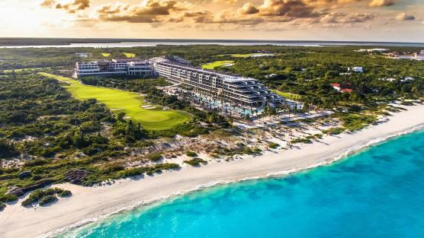
¡One Wedding Per Day!
CEREMONIES ($)
Legal
Symbolic
Catholic
Mayan
Hindu
Jewish
Atelier Weddings Hechas a mano

Slide 5
San José Chapel ($)
*Decore not included on the fee
Atelier Weddings Hechas a mano

Slide 6
Beach Area
Atelier Weddings Hechas a mano

Slide 7
Suspiro Atelier
Atelier Weddings Hechas a mano

Slide 8
Suspiro North
Atelier Weddings Hechas a mano

Slide 9
Limón & Sal Garden
Atelier Weddings Hechas a mano

Slide 10
Don Fernando Terrace
Atelier Weddings Hechas a mano

Slide 11
El Cielo Terrace
*Decore not included on the fee
Atelier Weddings Hechas a mano

Slide 12
Los Abrazos Black Terrace
Atelier Weddings Hechas a mano

Slide 13
Relax Sundeck
Atelier Weddings Hechas a mano

Slide 14
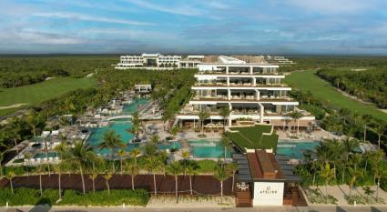
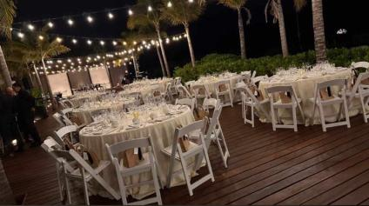
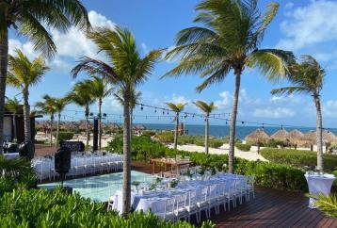
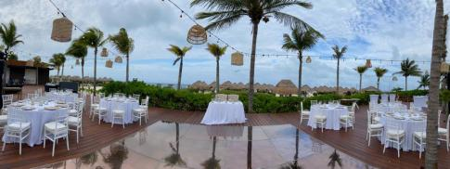
La Punta Deck
Atelier Weddings Hechas a mano

Slide 15
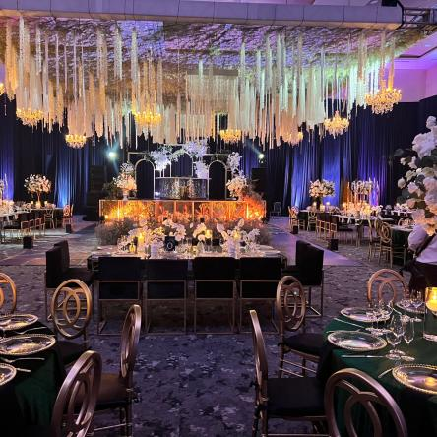
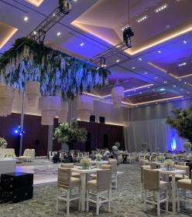
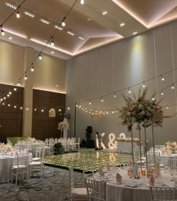
Ballroom
Atelier Weddings Hechas a mano

Slide 16
ATELIER PLAYA MUJERES (Adults Only) | ATELIER PLAYA MUJERES (Adults Only) | ATELIER PLAYA MUJERES (Adults Only) | ATELIER PLAYA MUJERES (Adults Only)
Event Type Venue | Welcome Cocktail | Ceremony | Cocktail & Reception
Beach area
Suspiro Atelier
Suspiro North
Limón & Sal Garden
Don Fernando Terrace
El Cielo Terrace ($)
Los Abrazos Black Terrace
Relax Sundeck
La Punta Deck
Atelier Weddings Hechas a mano

Slide 17
ATELIER WEDDING VENUES CAPACITY | ATELIER WEDDING VENUES CAPACITY | ATELIER WEDDING VENUES CAPACITY | ATELIER WEDDING VENUES CAPACITY | ATELIER WEDDING VENUES CAPACITY | ATELIER WEDDING VENUES CAPACITY | ATELIER WEDDING VENUES CAPACITY
Event Type Venue | Welcome Cocktail |  | Ceremony |  | Cocktail & Reception
Guests | Min | Max | Min | Max | Min | Max
Beach area | 50 | 250 | 50 | 150 | 50 | 250
Suspiro Atelier | - | - | - | - | 150 | *250
Suspiro North | - | - | - | - | 50 | *150
Limón & Sal Garden | 20 | 150 | 20 | 180 | 20 | 130
Don Fernando Terrace | 20 | 100 | 20 | 90 | - | -
El Cielo Terrace ($) | 20 | 100 | 20 | 100 | - | -
Los Abrazos Black Terrace | - | - | 100 | 150 | 50 | 100
Relax Sundeck | 20 | 150 | 20 | 100 | 20 | 130
La Punta Deck | 50 | 180 | 50 | 150 | 50 | 140
*Indoor & Outdoor location
Atelier Weddings Hechas a mano

Slide 18
Atelier Weddings Hechas a mano
Jeanett Baños
Wedding Sales Manager
Jeanett.banos@adh.com
T: +52 (998) 288 5724 ext. 5111
* POSSIBLE CHANGES WITHOUT PRIOR NOTICE MAY APPLY | PICTURES ARE FOR REFERENCE, DECORATION NOT INCLUDED.

